Slide 1

Smart Waste Classification and Recycling Assistant
Name: Habiba Helal Mohammed
Faculty: Faculty of Computers and Data Science, Alexandria University
Department: Artificial Intelligence
Training Provider: MAIM Company for Digital Solutions
Track: Computer Vision
Problem Statement
Improper waste sorting causes major environmental and recycling challenges.
Manual sorting is inefficient, error-prone, and labor-intensive.
Need for AI-powered automated waste classification system.
Applications: Smart bins, recycling plants, municipal services.
DatasetTrashNet:
Garbage Classification Dataset6
Categories: Glass, Paper, Cardboard, Plastic, Metal.
TrashTrain: 1768 images
Validation: 328
imagesTest: 431
imagesSource: Kaggle Garbage Classification Dataset
Dataset Link: Kaggle – Garbage Classification Dataset

Slide 2
Methodology
Data Preprocessing & AugmentationCleaning, resizing, normalization, classical augmentation.
CNNs & Transfer LearningBaseline CNN, ResNet, EfficientNet, MobileNet.
YOLO Detection ModelYOLOv5/YOLOv8 for waste localization.
GANs for Data AugmentationSynthetic data generation to address class imbalance.
Autoencoder for DenoisingNoise removal and feature learning.
Results
CNN: Lower baseline accuracy (~58%).
ResNet & EfficientNet: Strong generalization.
MobileNet: Lightweight, efficient, good balance.
YOLO: Accurate detection with bounding boxes.
GANs: Generated realistic but variable-quality images.
Autoencoder: Effective denoising (PSNR=30.60, SSIM=0.8769).
Ethical & Societal ImpactSupports
UN SDGs 11, 12, 13.
Global waste projected to reach 3.4B tons annually by 2050 (World Bank).
Societal Benefits:
Recycling efficiency
Cost & labor savings
Public awareness
Cleaner environments
Real-World ApplicationsSmart
Bins: Real-time classification feedback.
Recycling Plants: Automated pre-sorting.
Municipal Services: Optimized collection routes.
CSR Programs: Corporate sustainability integration.
Ethical Challenges
Dataset bias (clean images vs. real-world waste).
Energy & environmental cost of deep learning.
Accessibility gap between developed & developing regions.
Importance of fairness and green AI practices.

Slide 3
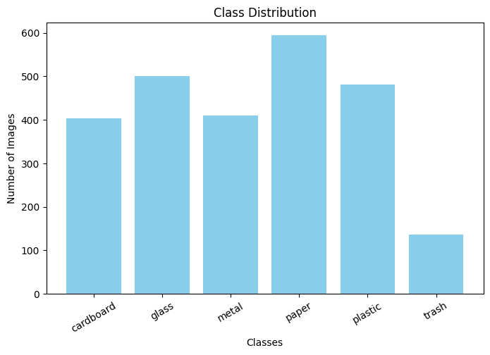
Dataset & Data Preprocessing
Garbage Classification Dataset (TrashNet), designed for computer vision tasks in waste classification and recycling applications.
It provides labeled images of six waste categories:
Cardboard (403 samples)
Glass (501 samples)
Metal (410 samples)
Paper (594 samples)
Plastic (482 samples)
Trash (137 samples)
The dataset is split into:
• Training set: 1768 images
• Validation set: 328 images
• Test set: 431 images
DATASET SAMPLES
PRE-PROCESSED SAMPLES
AUGMENTED SAMPLES

Slide 4
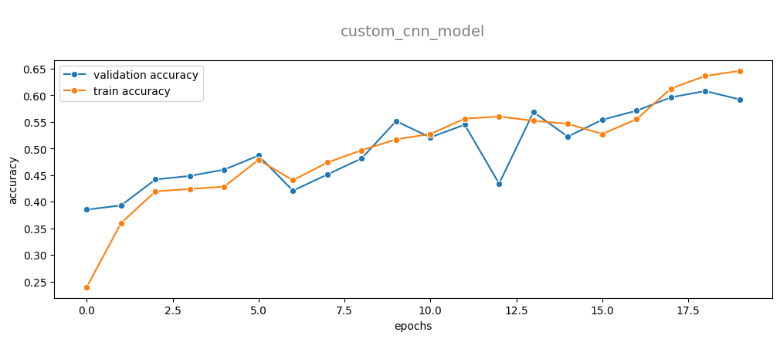
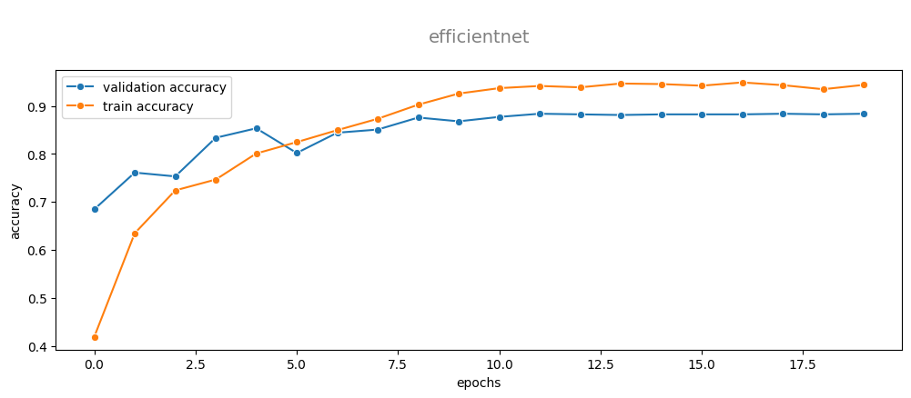
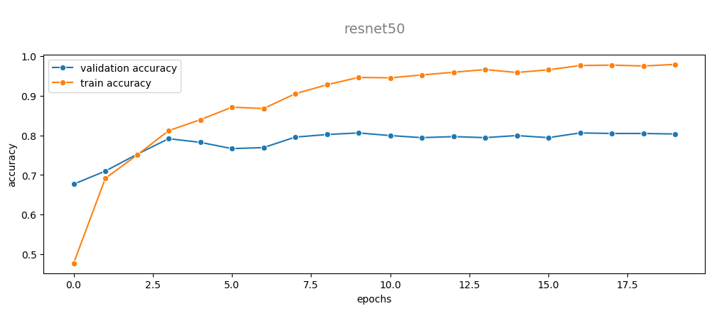
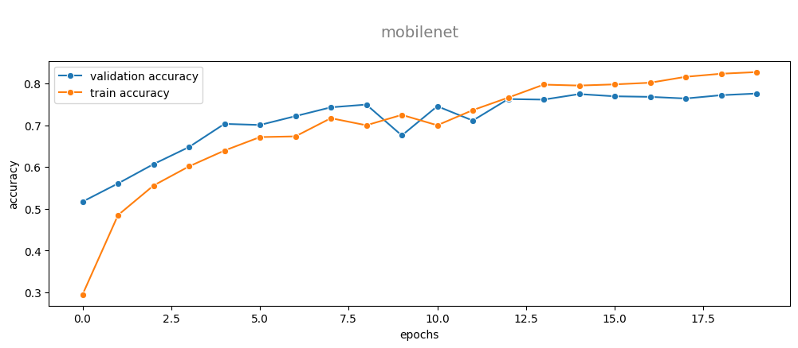
Deep Learning(CNNs) AND TRANSFER LEARNING for Waste Classification
RESULTS

Slide 5
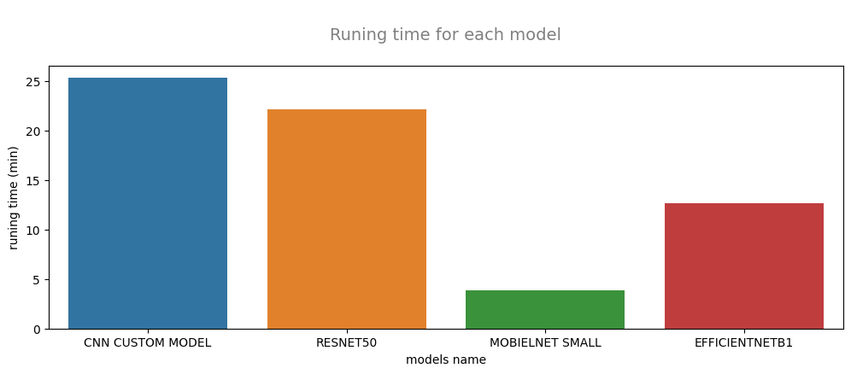
Pretrained Model | Validation Accuracy | Test Accuracy | Strength
EfficientNetB1 | ~88% | ~85% | Best accuracy + efficient.
ResNet50 | ~85% | ~82% | Robust, well-balanced.
MobileNetV3Small | ~83% | ~81% | Lightweight, good for mobile deployment.
VGG16 | ~80% | ~78% | High capacity, but heavier and less efficient.
Observations
•Transfer learning boosted accuracy by 20–30% compared to the baseline CNN.
•EfficientNetB1 was the best overall: high accuracy and efficiency.
•MobileNetV3Small offered a great balance for resource-constrained deployment.

Slide 6
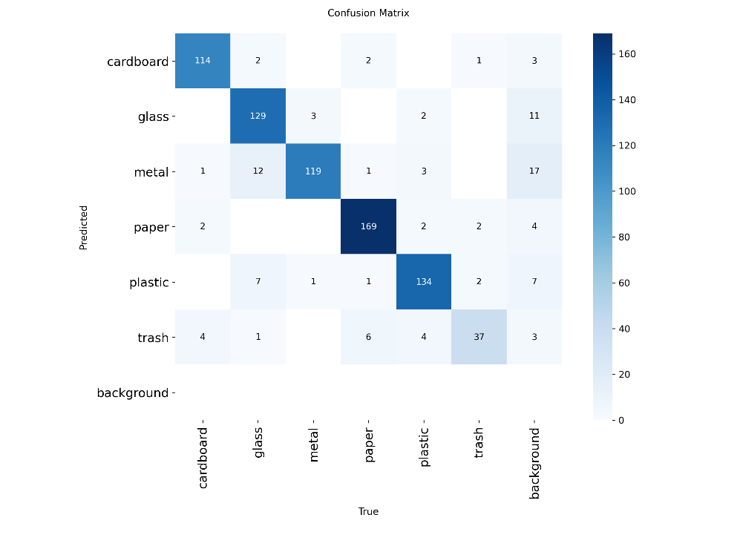
YOLOv8 Detection
YOLOv8 for real-time detection.
Preprocessing: Resize 640×640, normalization, augmentation.
Training: 50 epochs, batch size 16, Adam optimizer.
Results:
Precision: 0.919
Recall: 0.926mAP > 97%
Strongest: Paper, Cardboard, Glass
Weakest: Trash (confused with plastic/metal).

Slide 7
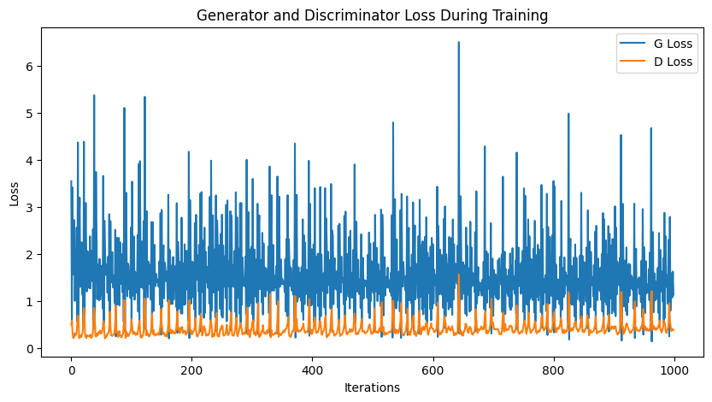
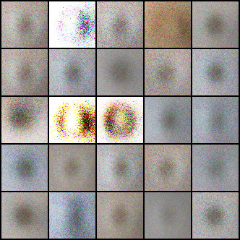
GANs for Augmentation
Generated synthetic waste images (3×64×64).
Training: 50 epochs, batch size 128, BCE loss.
Challenges:
Training instability
Mode collapse
Noisy/blurry outputs
Trade-off between quality vs. diversity of samples.

Slide 8

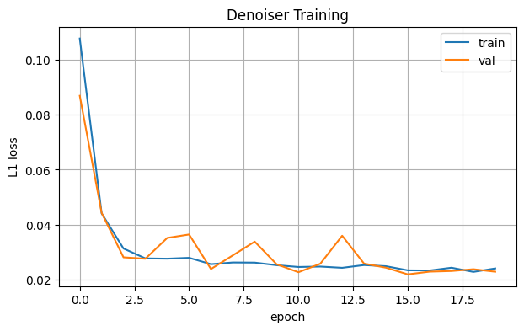

Autoencoder for Denoising
Encoder: Convolutional layers → latent representation.
Decoder: Transposed convolution layers → reconstruction.
Training: 20 epochs, batch size 128, Adam optimizer.
Results:
PSNR = 30.60 dB
SSIM = 0.8769
Outputs: Cleaner images, reduced Gaussian noise, preserved structure.

